Slide 1
Using Remote Learning to Turn Emergency into Opportunity June 29, 2020
To view closed captions > Select the Closed Caption button on your Zoom menu bar. Captions will appear along the bottom of your screen.
Notes:
The COVID-19 emergency school building closures have highlighted the importance of technology planning and contingency planning. For districts around the country, the “impossible” had to quickly become “possible”. The rapid shift to remote teaching and learning exposed areas of significant need in schools and districts, such as access to technology and addressing the needs of students with disabilities. In the context of these challenges, building a strong and inclusive technology ecosystem that incorporates assistive technology, educational technology, and information technology is more critical than ever. In this webinar, leaders at the Center for Inclusive Technology and Education Systems (CITES) will discuss identifying the challenges uncovered by the shift to emergency remote learning, and how school systems can use best practices in technology planning to convert the discovery of challenges into an opportunity to develop innovative solutions.

Slide 2
Goal for Today
To identify bright spots in the COVID-19 crisis and potential positive strategies to bring forth to the fall despite unknowns about school building reopening.

Slide 3
Agenda
Brief Intro to CITES
Emergency Remote Learning and COVID-19
Mapping the Challenges
Potential Opportunities
Remote Learning Data to Inform Next Steps
Q & A

Slide 4
Contribute to the Conversation
Chat​
Share your thoughts, experiences, ideas with other attendees​
Q&A​
Post your questions for the panelists​

Slide 5
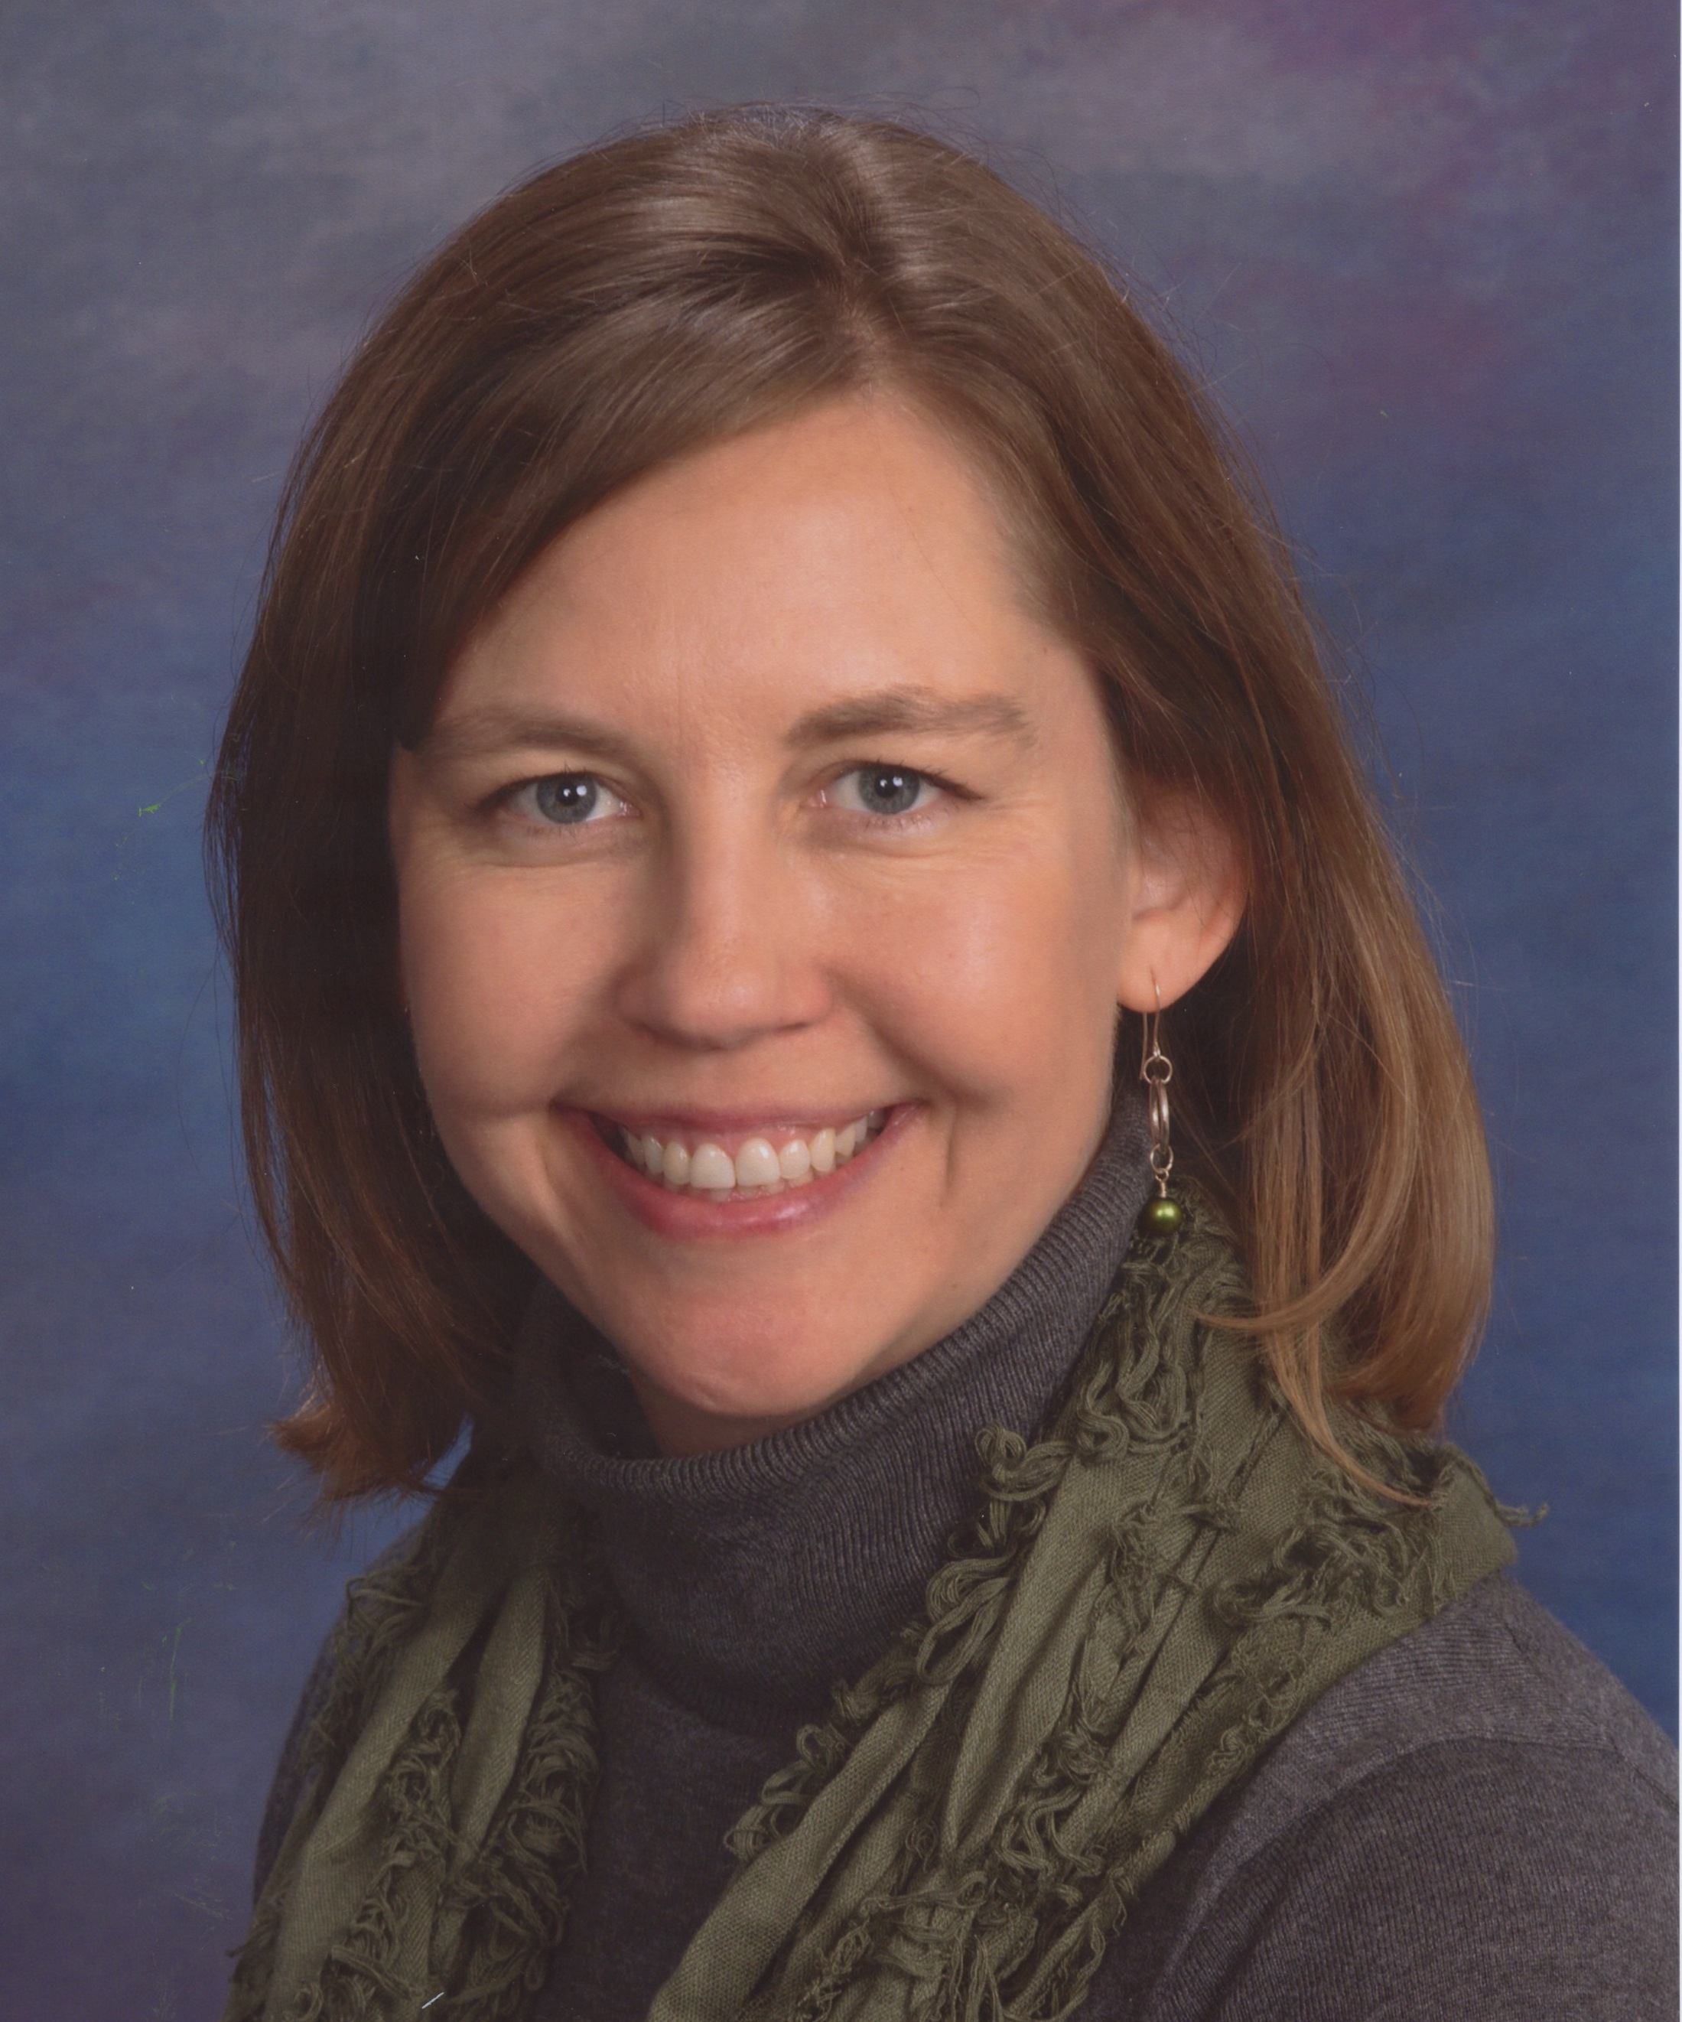
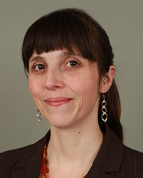
About the presenters
Janet Peters​
jpeters@cast.org
@JanetLPeters​
Alise Crossland​ ​ acrossland@air.org @AIRInforms​

Slide 6
Center on Inclusive Technology and Education Systems
The overarching goal of CITES is to increase the effective use of Assistive Technology (AT) , Educational Technology (EdTech), and Informational Technology (InfoTech) by students with disabilities and their families by building the capacity of school districts to implement comprehensive and sustainable technology ecosystems.

Slide 7
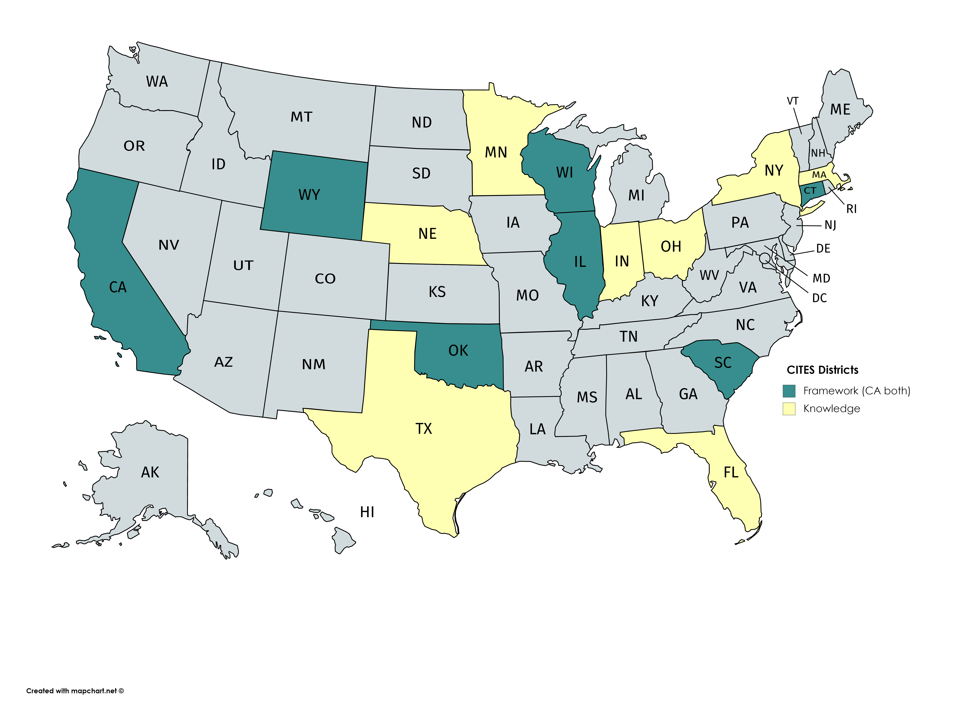
Working With Districts Nationwide
Lessons learned from Knowledge Development Districts
Targeted technical assistance to Framework Development Districts
Universal technical assistance to all districts, especially as we weather this time of crisis

Slide 8
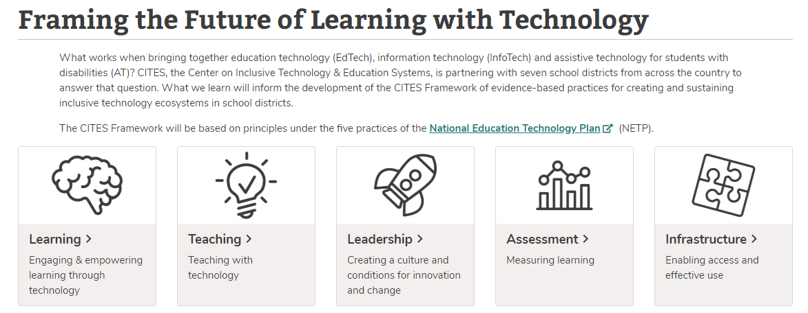
CITES Framework and the National Education Technology Plan (NETP)
CITES is using the NETP as a foundation for our Framework

Slide 9
The Time Is Now!
If technology systems work together, it increases the chances for students to be successful learners in this new distance education environment.

Slide 10
Shift to Remote Learning: Mapping the Challenges

Slide 11
A National Agenda for Equity and Access
“..institutions should develop and implement learning resources that embody the flexibility and power of technology to create equitable and accessible learning ecosystems that make learning possible everywhere and all the time for all students…” (2017 National Education Technology Plan)

Slide 12
Remote Learning Exposed Areas of Need…
Access and equity – the “homework gap” became a “schoolwork gap”
Need for new teaching strategies and best practices to teaching with technology
Building educator capacity – rapid deployment of PD
Addressing the needs of students with disabilities and English learners online

Slide 13
…And Illuminated Gaps in Planning
Flawed or even understanding of equity gaps in schools and districts
Flawed or uneven solutions to existing gaps in schools and districts

Slide 14
From Impossible to Possible
“I handed in my five-year strategic plan two years ago, and it included one-to-one technology within the five years. We met as a cabinet over spring break and the superintendent looked at me and said, ‘Ken, we need to do it now.’”
- Kenneth Thompson, Chief Information Security Officer, San Antonio Independent School District

Slide 15
Shift to Remote Learning: Opportunities for Solutions

Slide 16
Emergency to Opportunity
What are the implications of what we know now?
Where are the bright spots (what worked well)?
What is the silver lining?

Slide 17
Bright Spots
Image by Pexel, Andrea Piacquadio

Slide 18
Group Share/Discussion
What solutions did you see in your school/district to address challenges exposed by school building closures?
Could elements of those solutions be scaled up?

Slide 19
Using Remote Learning Data to Inform Next Steps

Slide 20
Finding Where We Are
What do we now know?
Where are we now?
Where do we want to go?
How are we going to get there?

Slide 21
Evaluating How it Went
What internal and external resources were required to support the shift to remote learning? Was your district’s infrastructure sufficient? Where are there still gaps?
What strategies did your district use to roll out remote learning? What worked well?
What professional development did teachers need to get started? What worked well? What didn’t?
What feedback did you collect from families and students about remote learning?
What strategies did your district use to provide AT and needed services to students with disabilities and their families? What worked well?

Slide 22
Discussion
What happens next (immediately, in 3 months, in 6 months) in education? What do you hope happens?
What do you want to keep and what do you want to do differently?
What are the implications for your work? Who do you need to collaborate with to implement this vision?

Slide 23
How do we get there
Coordination
Collaboration
Communication
Continuity

Slide 24
Time for Q&A

Slide 25
"Start where you are. Use what you have. Do what you can."
-Arthur Ashe

Slide 26
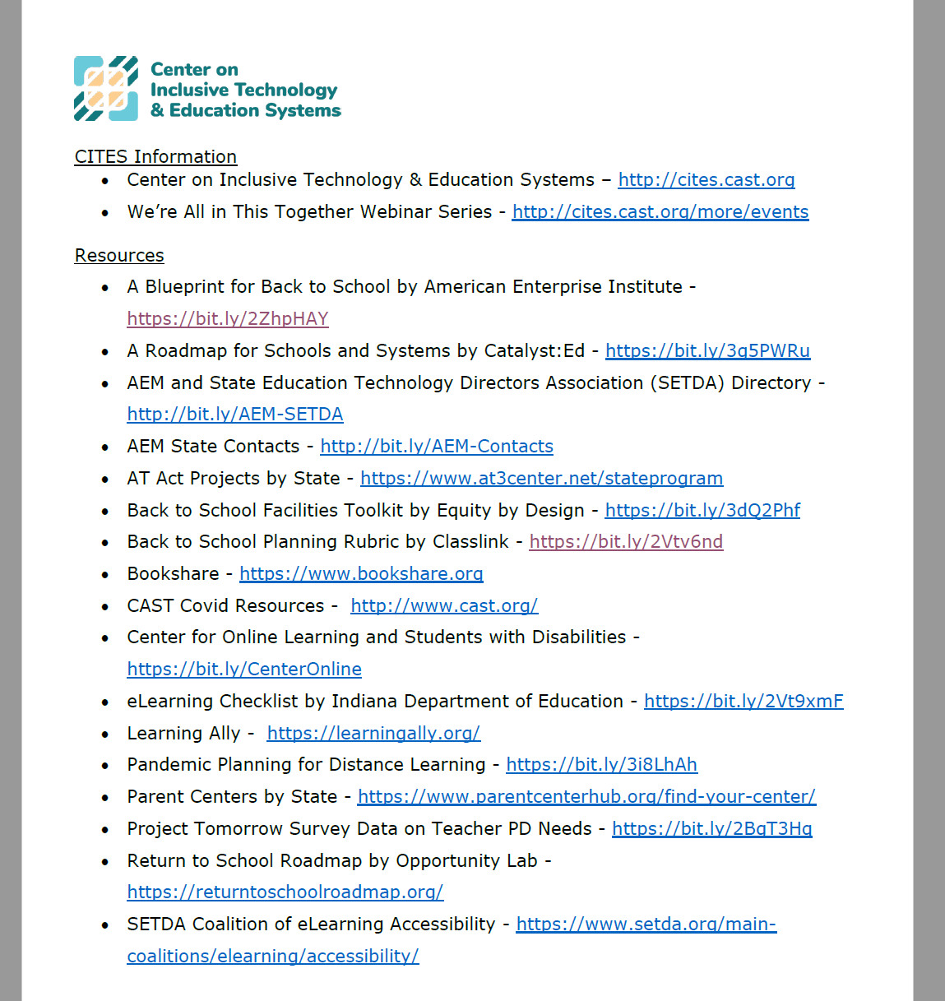
Handout with Links from this Session
https://bit.ly/2VpY0EM
Notes:
Handout Link - https://cast1984.sharepoint.com/:b:/s/citesteam/Ee6BniYl11hDgNN3icZj4qwBGdRtzZ_BwXwOdhWiaZyNkg?e=W1h6XU

Slide 27
Thank you! Keep in touch!
Join our email list at mailchi.mp/cast/cites
Website: cites.cast.org
Email: cites@cast.org
Phone: 781-245-2212
200 Harvard Mill Square, Suite 210 Wakefield, MA 01880
EVALUATION LINK: https://www.surveymonkey.com/r/NB2FJ67
Notes:
EVALUATION LINK: https://www.surveymonkey.com/r/NB2FJ67

Slide 28
OSEP Disclaimer
This content was developed under a grant from the US Department of Education, #H327T180001. However, the contents do not necessarily represent the policy of the US Department of Education, and you should not assume endorsement by the Federal Government. Project Officers: Tara Courchaine, Ed.D. & Anita Vermeer, M.Ed.

