Slide 1
Technology Leadership in Practice
Moderators: Alise Crossland and Kristin Ruedel, American Institutes for Research
Panelists: Tiffani Brown (Grossmont Union HS District); Janna Greathouse (Jenks Public Schools); Sarah Harris (Wethersfield Public Schools)
November 17, 2020

Slide 2
Session Agenda
  Overview of the CITES Framework Development
  Discussion of leadership practices with the Framework panelists
  Q & A
  Sharing of Tools and Resources

Slide 3
Objectives
After this session, you will be able to:
Define the CITES key leadership practices for inclusive technology planning
Examine your current leadership practices for technology planning
Apply lessons learned from the panelists to support your work

Slide 4
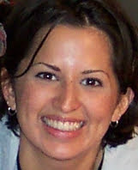
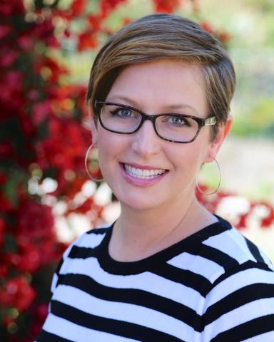

Our Framework Development Panelists
Tiffani Brown (Grossmont Union HS District)
Janna Greathouse (Jenks Public Schools)
Sarah Harris (Wethersfield Public Schools)

Slide 5
CITES Framework Development

Slide 6

The Big Picture
The overarching goal of CITES is to increase the effective use of Assistive Technology (AT) and Educational Technology (EdTech) and Information Technology (InfoTech) by students with disabilities and their families by building the capacity of school districts to implement comprehensive and sustainable technology ecosystems.

Slide 7

The CITES Framework
CITES is building a Framework to support the development of a inclusive technology ecosystem in school districts.
Notes:
The goal of CITES is to assist districts to create and sustain inclusive technology ecosystems that foster the intentional collaboration between educational technology, assistive technology, and information technology to benefit students with disabilities, and all students. To achieve our goal we are building a framework to support LEAs in this work. We are co-developing the CITES Framework with, you, our Framework Development Districts.

Slide 8

Phases of Framework Development
Leadership
Instruction
Family Engagement
Notes:
We are approaching the Framework development in three phases, leadership, instruction, and family engagement. But as interweaving graphic displays, these phases are interconnected and dependent on each other.

Slide 9
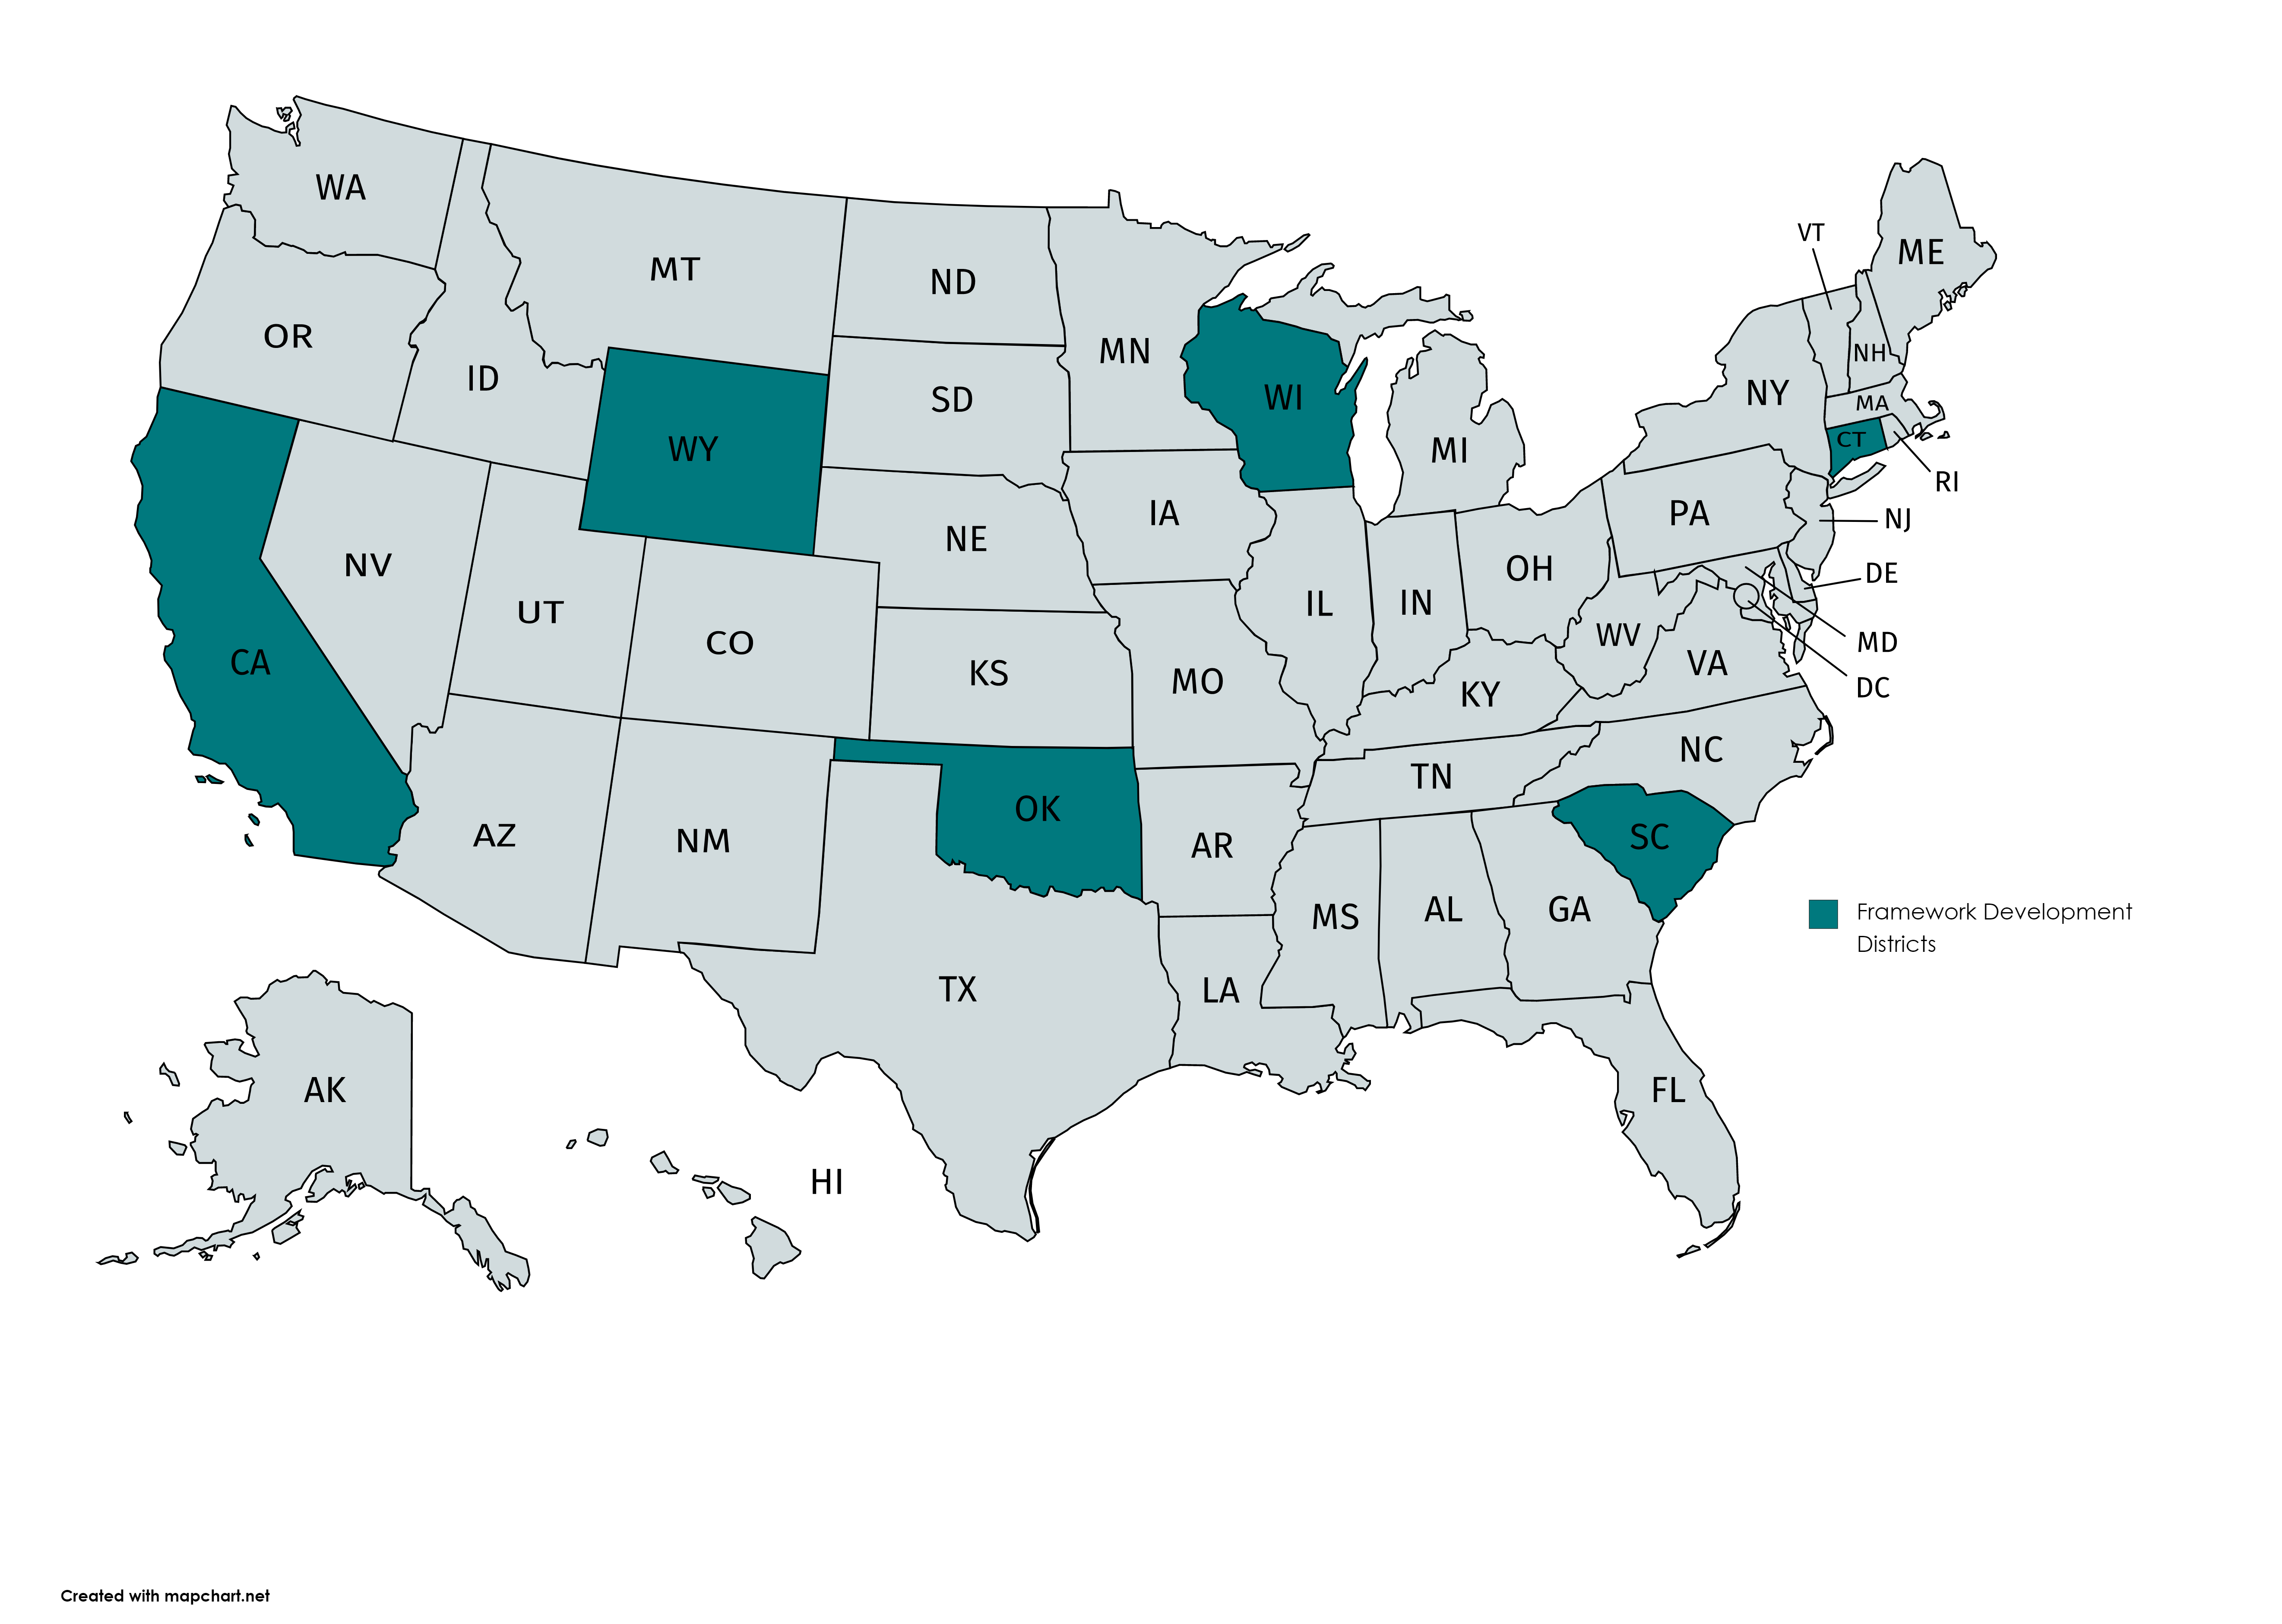
CITES Framework Development Districts
Florence One Schools
Grossmont Union High School District
Hayward Community School District
Jenks Public Schools
Laramie County School District
Placer County Office of Education
Wethersfield Public Schools: Wethersfield, Connecticut

Slide 10
CITES Framework: Leadership Practices
Create a community-wide vision and aligned goals
Develop a strategic technology implementation plan
Measure progress for continuous improvement
Engage families in collaborative activities
Develop clear outcomes for professional learning
Take ownership of infrastructure development

Slide 11
Determining Readiness

Slide 12
It takes time, effort, and collaboration
Building an inclusive technology ecosystem requires a shared vision among all stakeholders
Leaders and champions can foster a culture of collaboration and unity of purpose across the system
What factors and conversations led you to the work of enhancing your technology ecosystem?

Slide 13
Grossmont Union HS District
District Overview
  Approximately 16,500 students; rural and suburban
  14.2% SWDs; 9.2% ELLs; 20.5% free/reduced lunch
Our starting point
Technology Roadmap
Notes:
2 – 3 Minutes

Slide 14
Jenks Public Schools
District Overview
  Approximately 14,000 students; suburban
  17.2% SWDs; 11.4% ELLs; 13% free/reduced lunch
Our starting point
Technology Vision and Plan (2020 - 2022)
Notes:
2 – 3 Minutes

Slide 15
Wethersfield Public Schools
District Overview
  Approximately 3,540 students; suburban
  13.5% SWDs; 9.1% ELLs; 24.6% free/reduced lunch
Our starting point
WPS Technology Vision (working doc)

Slide 16
The CITES Self-Assessment

Slide 17
Overview of the CITES Assessment
Purpose: to support teams in establishing a baseline of the current state of the district’s inclusive technology ecosystem and monitor progress over time
Provides a numerical “snapshot” of where the district is on each CITES leadership practice

Slide 18
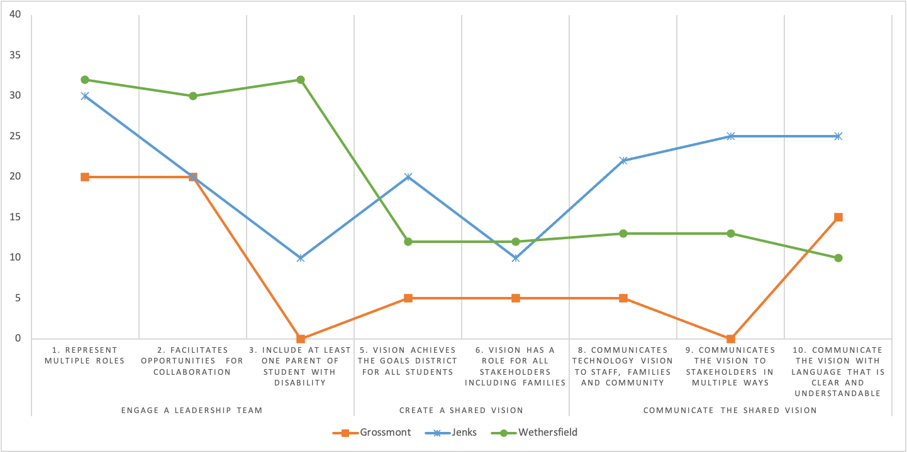
Self-Assessment Results: Creating a Community-wide Vision

Slide 19
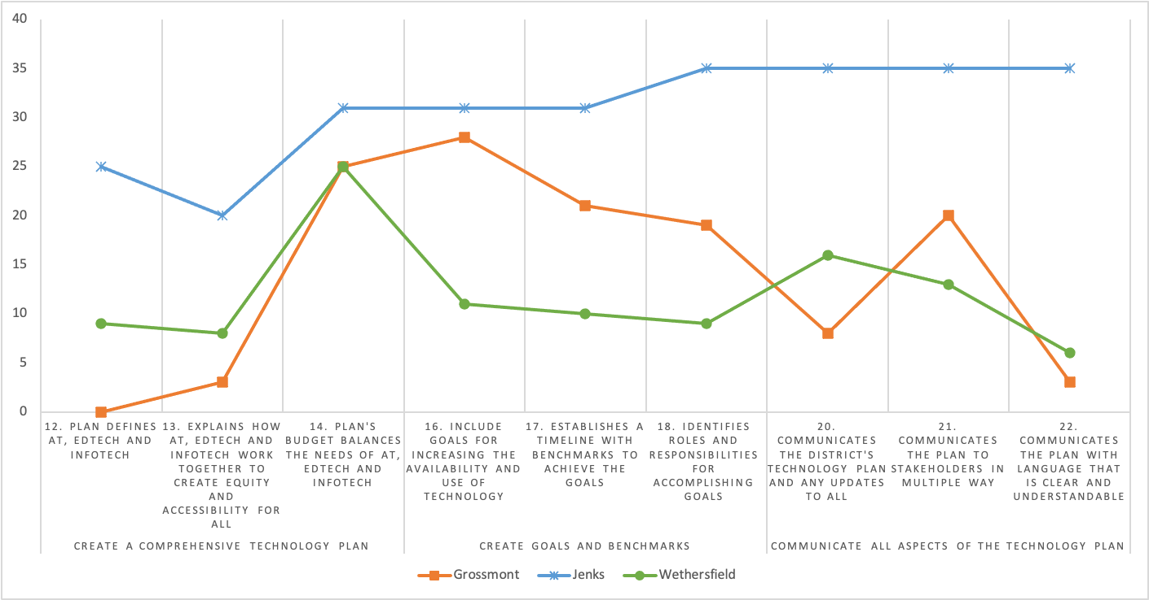
Self-Assessment Results: Develop a Strategic Technology Implementation Plan

Slide 20
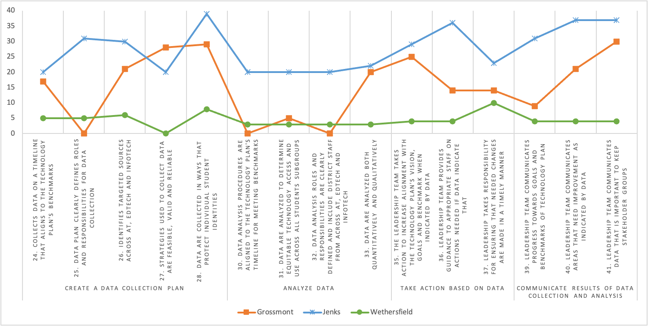
Self-Assessment Results: Measure Progress for Continuous Improvement

Slide 21
Reflection and Lessons Learned

Slide 22
Spreading the Learning
What has been critical to your work?
What strategies and leadership practices have been most effective in helping you to move the work forward and overcome challenges along the way?
Notes:
5 minutes

Slide 23

Discussion

Slide 24
Tools and Resources
Key Questions to Consider When Creating an Inclusive Technology Ecosystem – bit.ly/CITES-Leadership
Website: cites.cast.org

Slide 25
Feedback
Please take a couple of minutes to complete an evaluation survey from our external evaluator. Your feedback is very important to us and we appreciated your input!
https://www.research.net/r/CITES_11-17

Slide 26




Connect with Us!
Website: cites.cast.org
Email: cites@cast.org
Phone: 781-245-2212
Address: 200 Harvard Mill Square, Suite 210 Wakefield, MA 01880

Slide 27
Disclaimer
The contents of this presentation were developed under a cooperative agreement with the U.S. Department of Education, OSEP #H327T180001. However, contents do not necessarily represent the policy of the U.S. Department of Education and you should not assume endorsement by the Federal Government, Project Officers, Tara Courchaine, Ed.D. and Anita Vermeer M.Ed.

