Slide 1
Make a Copy of this Deck.
Do not edit!
Wahoo!

Slide 2
CITES Myths and Facts Slide Deck
Created 10/2024 & updated 4/2025

Slide 3
Accessibility Commitment: POUR
All of these resources will be:
Perceivable
Alt text on images
High color contrast
Readable font
Video with closed captions
Video with audio descriptions
Operable
Distinct slide titles
Shortened links with descriptive back-halves
Understandable
Clear structure and layout
Consistent formatting
Effective use of images
Robust
Checked for accessibility using both accessibility check built into PowerPoint and a manual test by a user of assistive technology
Notes:
Christine

Slide 4
Tips for Using this Slide Deck
The Myths and Facts are grouped in the AT Myth & Fact Guidance categories
Titles on slides are the AT Myth & Fact number that match that graphic
There are 26 AT Myth & Fact Graphics in this deck
AT Myth & Fact # 14 is not included because it is so similar to Myth & Fact # 13
Consider hiding slides you don’t want to use
We want to know! Please share stories of how and who you have used the AT Myths & Facts Graphics, Game and this Deck with: email cites@cast.org

Slide 5
AT Cost & Funding
AT Myths & Facts #27 & 28

Slide 6

AT Myth & Fact 27

Slide 7

AT Myth & Fact 28

Slide 8
AT Devices & Services
AT Myths & Facts #'s 9-18

Slide 9

AT Myth & Fact 9

Slide 10

AT Myth & Fact 10

Slide 11
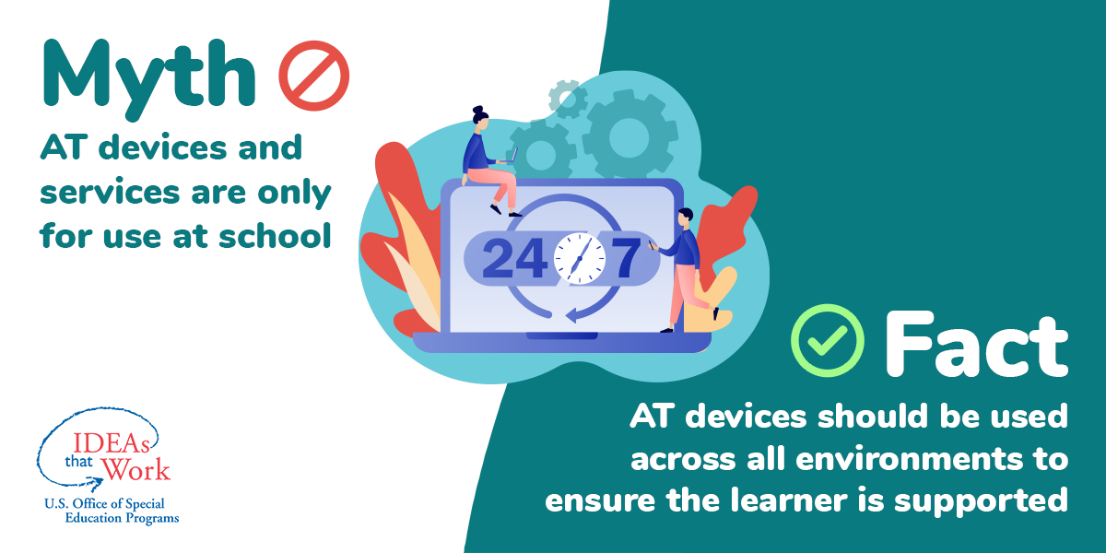
AT Myth & Fact 11

Slide 12

AT Myth & Fact 12

Slide 13

AT Myth & Fact 13

Slide 14

AT Myth & Fact 14

Slide 15

AT Myth & Fact 15

Slide 16

AT Myth & Fact 16

Slide 17

AT Myth & Fact 17

Slide 18
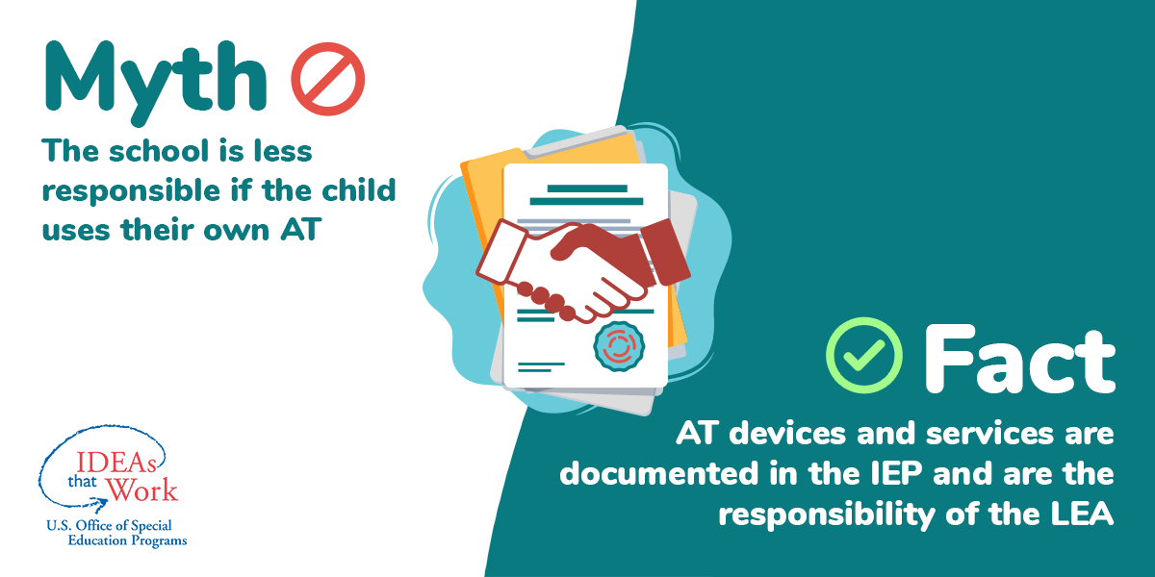
AT Myth & Fact 18

Slide 19
AT Requirements Under IDEA (Part B)
AT Myths & Facts #’s 1-8

Slide 20
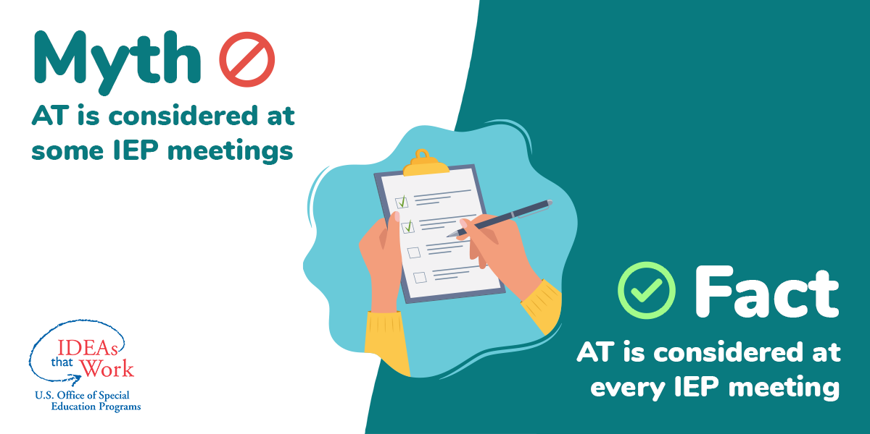
AT Myth & Fact 1

Slide 21
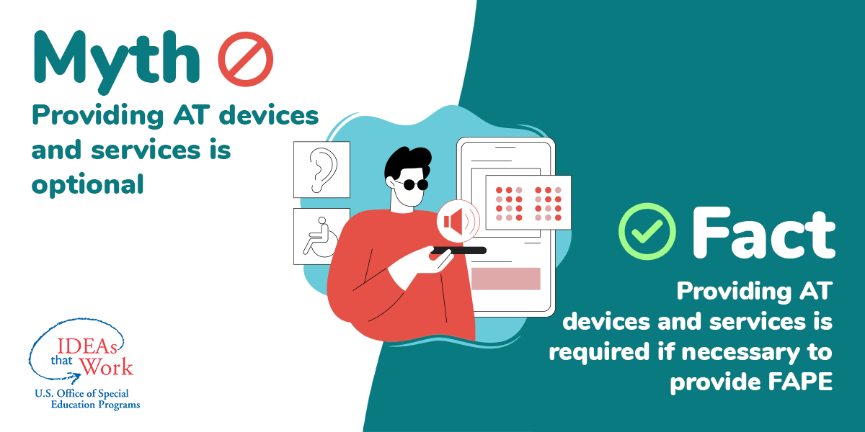
AT Myth & Fact 2

Slide 22

AT Myth & Fact 3

Slide 23
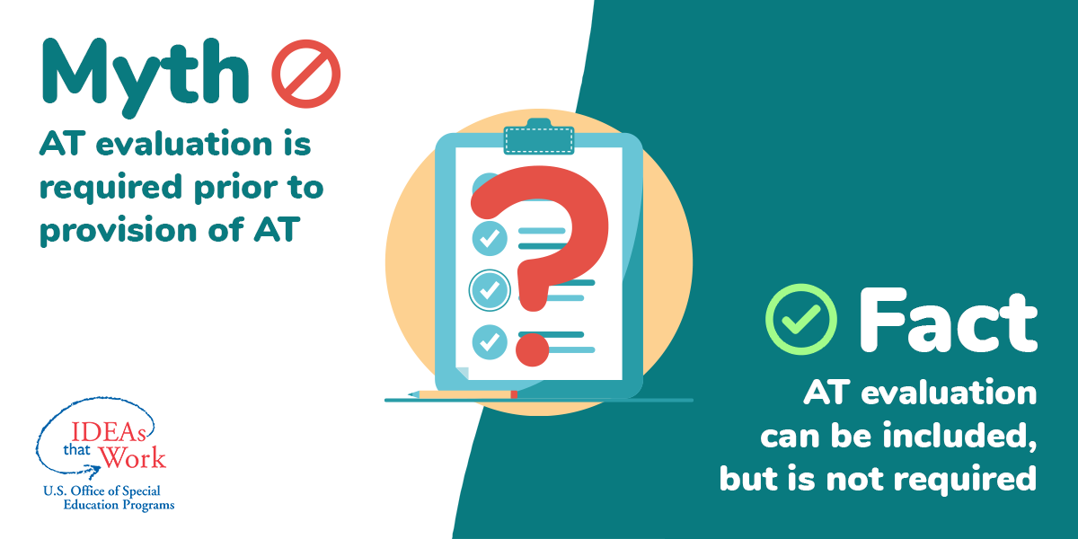
AT Myth & Fact 4

Slide 24

AT Myth & Fact 5

Slide 25

AT Myth & Fact 6

Slide 26

AT Myth & Fact 7

Slide 27
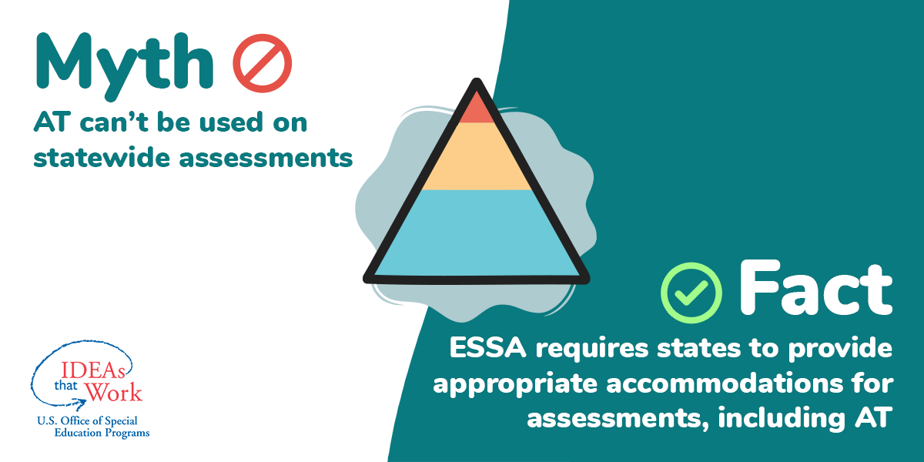
AT Myth & Fact 8

Slide 28
AT Requirements Under IDEA (Part C)
AT Myths & Facts #’s 23-26

Slide 29

AT Myth & Fact 23

Slide 30

AT Myth & Fact 24

Slide 31

AT Myth & Fact 25

Slide 32

AT Myth & Fact 26

Slide 33
Deploying AT Devices and Services
AT Myths & Facts #’s 19-22

Slide 34

AT Myth & Fact 19

Slide 35
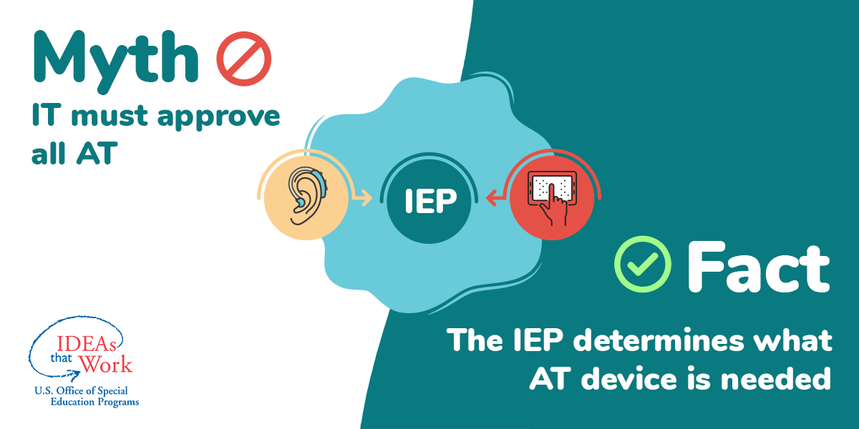
AT Myth & Fact 20

Slide 36

AT Myth & Fact 21

Slide 37

AT Myth & Fact 22

Slide 38
CITES Community of Practice
Join the conversation:​
Bi-Monthly open community meetings via zoom​
Slack channel discussions​
Social media networking​
  Would you like to invite others to the CITES Community of Practice?​
  Please do! Here is an invitation link to share.​
  bit.ly/JoinCITES

Slide 39






Thank you! Stay connected.
Website: cites.cast.org
Professional Learning: castpl.org
Books & Media: publishing.cast.org
Email: cites@cast.org
Phone: (781) 245-2212
50 Salem St.
Building B, Ste 303
Lynnfield, MA 01940

Slide 40


Creative Commons
Resource created by The Center on Inclusive Technology & Education Systems at CAST and licensed under a Creative Commons Attribution-NonCommercial-NoDerivatives 4.0 International License. All other rights reserved related to third party content. Resource contact(s): cites@cast.org

Slide 41
Disclaimer
This content was developed under a grant from the US Department of Education, #H327T180001 and #H327T230001. However, the contents do not necessarily represent the policy of the US Department of Education, and you should not assume endorsement by the Federal Government. Project Officer: Anita Vermeer, M.Ed.

