Slide 1
We’re All in This Together: Continuity In-the-Trenches
May 19, 2020

Slide 2
Session Agenda
Introductions
Review Coordination from the 4Cs
The Panel
Daniel McNulty, PATINS Project Indiana
Jenna Gravel, CAST Massachusetts
Jon Fila, ISD 287 Minnesota
Discussion
Resources
VI. Q & A

Slide 3
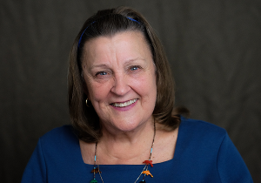
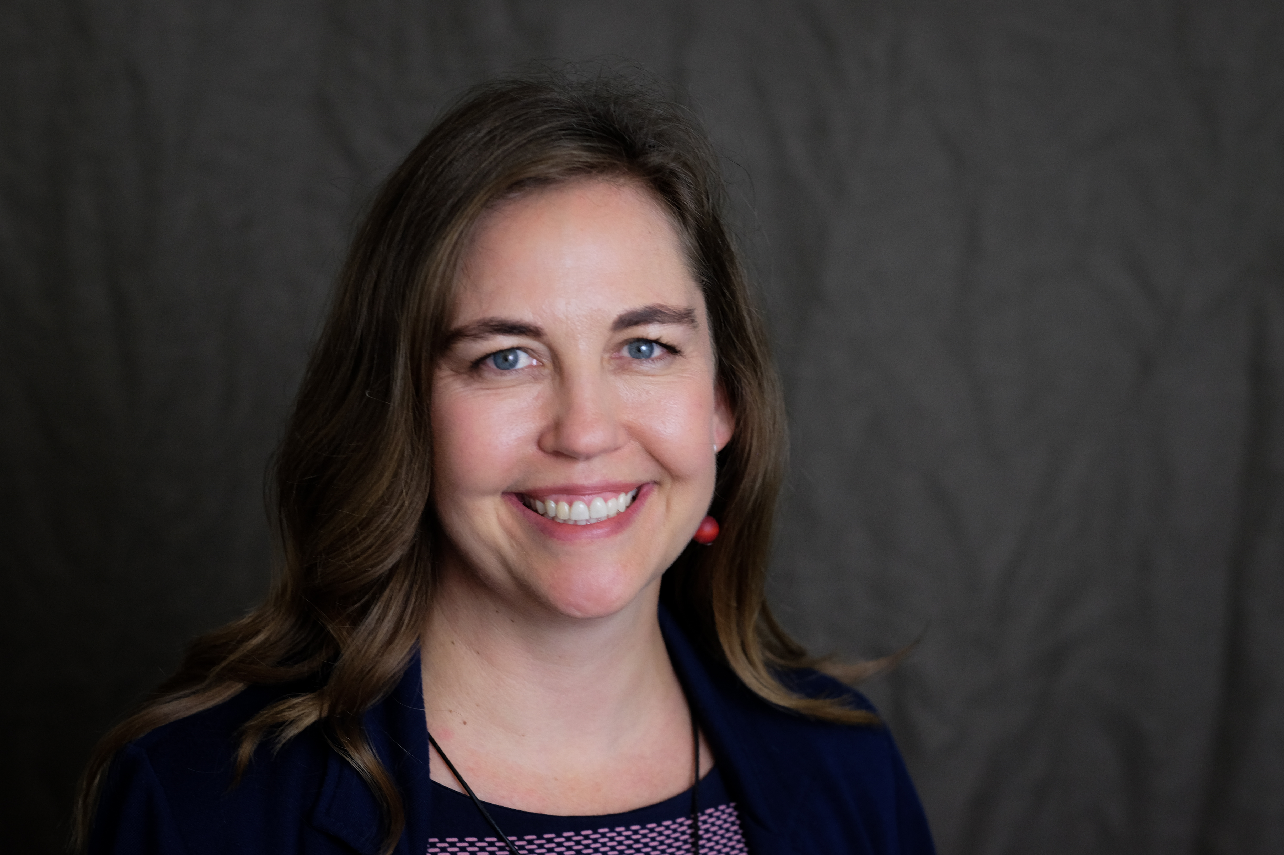
About US
The overarching goal of Center on Inclusive Technology and Education Systems (CITES) is to engage districts in the creation of technology ecosystems that include Assistive Tech (AT), Educational Tech (EdTech) and Information Tech (InfoTech) so that students with disabilities and their families can benefit from technology-supported learning opportunities.
Joy Zabala
jzabala@cast.org​
@joyzabala
Janet Peters​
jpeters@cast.org​
@JanetLPeters​

Slide 4
POLL 1
Please share your focus area
Notes:
Please share your specialty or focus area:
Assistive Technology
Educational or Instructional Technology
Information Technology
Family or Caregiver
General Education Teacher
Special Education Teacher
State or Federal Program
Service Provider
Other

Slide 5
Goal
The goal of this session is to
Provide in-the-trenches examples of a systems approach for thinking and operating during the crisis
Focus on technology-supported distance learning as a major component of a system of supports
Share successes in emergency distance learning and consider which should continue into the future

Slide 6
Review of the 4 Cs
Technology
Coordination
Collaboration
Communication
Continuity
Continuity
Communication

Slide 7
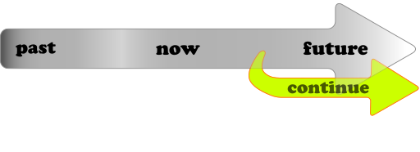
Continuity: In the Future
WHAT? Consider lessons learned and review data to determine what worked, which tools and strategies will be kept and which will be discontinued
HOW?
Determine what effectiveness "looks like"
Keep data on which tools and strategies "worked" during the crisis
Analyze data to inform decisions
Notes:
Image from https://commons.wikimedia.org/wiki/File:Straight_Line_Steady_2.svg

Slide 8
"Start where you are. Use what you have. Do what you can."
-Arthur Ashe

Slide 9
Introduction to our Panelists

Slide 10
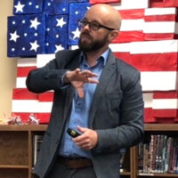
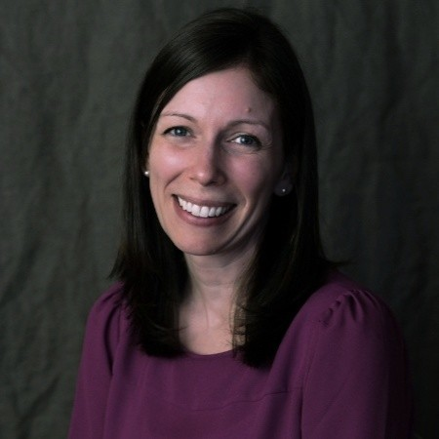
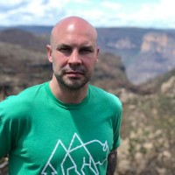
The Panelists

Slide 11
Discussion Question 1
What are you learning during the crisis that will be helpful for schools as they prepare for the future?

Slide 12
Discussion Question 2
In what ways are accessibility of technology or AT and EdTech integration different now than before?

Slide 13
Discussion Question 3
How can we collect and use data that inform us about which practices should or should not continue into the future?

Slide 14
Panelist Parting Thoughts

Slide 15
Time for Q&A

Slide 16
“Do the best you can and when you know better, do better"
-Maya Angelou

Slide 17
Thank you! Keep in touch!
Website: cites.cast.org
Email: cites@cast.org
Phone: 781-245-2212
200 Harvard Mill Square, Suite 210 Wakefield, MA 01880
EVALUATION LINK: https://www.surveymonkey.com/r/6RKVMZW
Notes:
https://www.surveymonkey.com/r/S5HFRDS

