Slide 1
We’re All in This Together: Coordination In-the-Trenches
May 12, 2020
Notes:
In this webinar, CITES leaders host a conversation with CITES advisors and colleagues in-the-trenches to take a closer look at Coordination. We will discuss services that may be available through school and community organizations. The session will provide examples of services that enable students and families to participate and achieve while learning at a distance. There will be time for questions at the end of the presentation.

Slide 2
Session Agenda
Introductions
Review Coordination from the 4Cs
The Panel
Angela Lindig, Idaho Parents Unlimited
Janice Carson, Idaho Assistive Technology Project
Susan Hardin, Macomb ISD Michigan and UDL -IRN
Discussion
Resources
VI. Q & A
Notes:
Guest panelists: Janice Carson (Idaho Assistive Technology Project), Susan Hardin (Macomb ISD/UDL-IRN), Angela Lindig (Idaho Parents Unlimited)

Slide 3
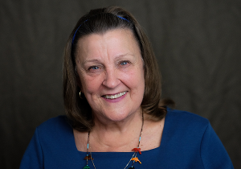
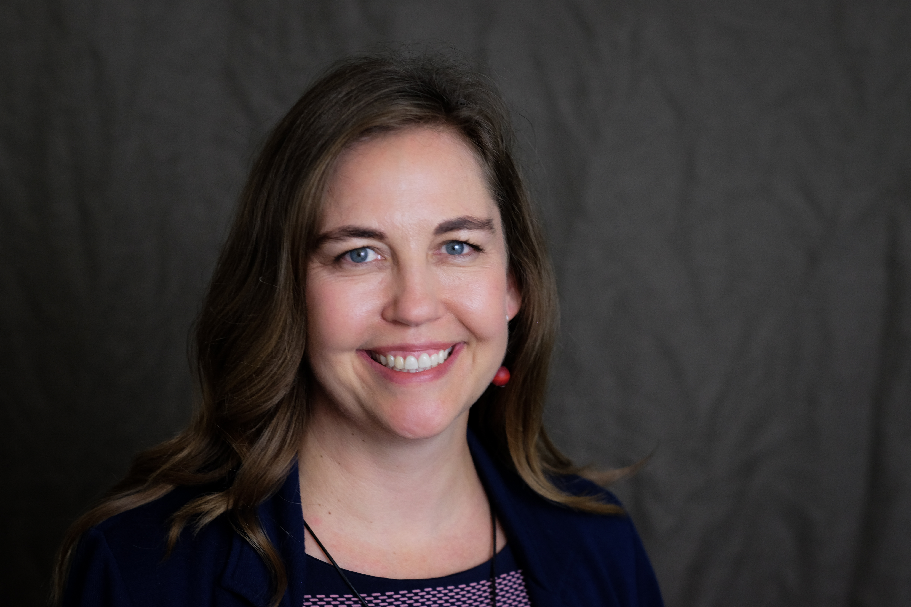
About Us
Joy Zabala
jzabala@cast.org​
@joyzabala
CAST’s Mission is to Transform Education Design and Practice Until Learning Has No Limits. CAST created Universal Design for Learning (UDL), research-based set of principles to guide the design of learning environments that are accessible and effective for all.
Janet Peters​
jpeters@cast.org​
@JanetLPeters​

Slide 4
POLL 1
Please share your focus area
Notes:
Please share your specialty or focus area:
Assistive Technology
Educational or Instructional Technology
Information Technology
Family or Caregiver
General Education Teacher
Special Education Teacher
State or Federal Program
Service Provider
Other

Slide 5
POLL 2
Where are you joining us from?
Notes:
North East
North Central
North West
South East
South Central
South West
Other

Slide 6
"Start where you are. Use what you have. Do what you can."
-Arthur Ashe

Slide 7
Goal
The goal of this session is to
Provide in-the-trenches examples of a systems approach for thinking and operating during the crisis
Focus on technology-supported distance learning as a major component of a system of supports
Share community and services organizations that supporting technology use for schools and families

Slide 8
Review of the 4 Cs
Technology
Coordination
Collaboration
Communication
Continuity
Continuity
Communication

Slide 9
4 Cs -The Who, The What and the How
The WHO is consistent across all four Cs
Educational administrators, general education teachers, special education teachers, parents and guardians, and students
Leaders in InfoTech, EdTech, and Assistive Technology

Slide 10
Coordination
WHAT? Coordinate services so that all students and families have what they need to participate and achieve while learning at a distance
HOW?
Determine what tech and strategies are being used and how to build upon them as needed
Provide initial and ongoing support
Develop strategies for students who do not have or cannot benefit from online work
Notes:
Image by skeeze on Pixabay
Coordination: Establish a core team of representatives from administration, general ed, special ed, educational technology, AT, parents & guardians. Develop guidelines and protocols for use across the system to ensure that students who use AT and need AEM and accessible technologies have what they need to make progress in whatever distance education plan is in use

Slide 11
Introduction to our Panelists

Slide 12
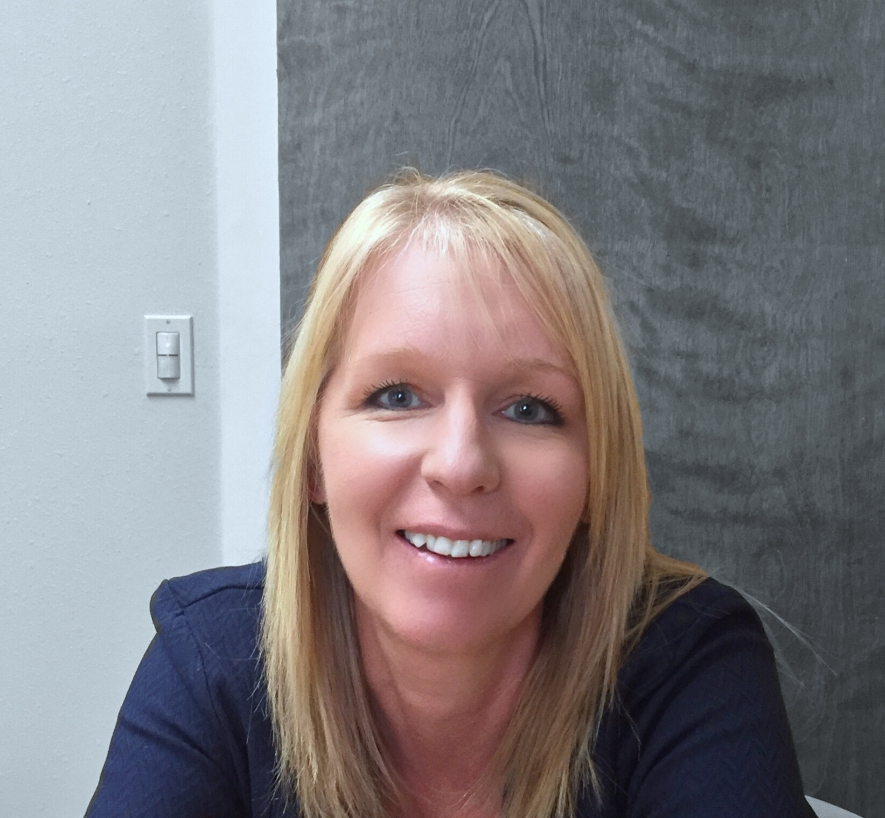
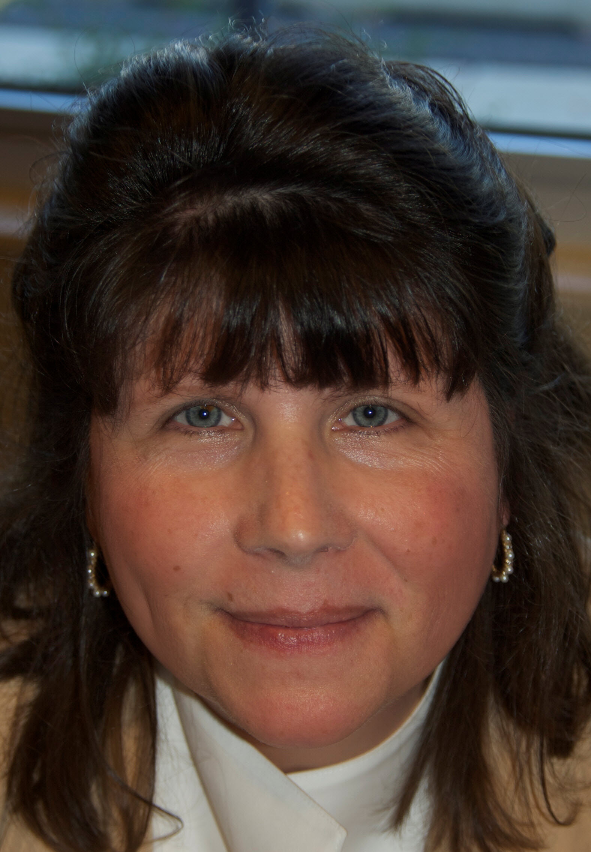
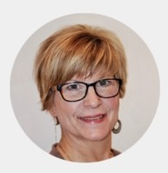
The Panelists
Angela Lindig

Slide 13
Discussion Question 1
What are you hearing in-the-trenches?

Slide 14
Discussion Question 2
What innovations or creativity regarding Coordination is happening in your area?

Slide 15
Discussion Question 3
In your experience, what community and services organizations can support technology for schools and families?

Slide 16
Panelist Parting Thoughts

Slide 17
Time for Q&A

Slide 18
Resources

Slide 19
Highlighted Resources
Link Handout - https://bit.ly/CITES-5-12
Parent Training and Information Resources
AT Act Project, One in Every State
Family-to-Family Health Information Centers

Slide 20
“Do the best you can and when you know better, do better"
-Maya Angelou

Slide 21
Thank you! Keep in touch!
Website: cites.cast.org
Email: cites@cast.org
Phone: 781-245-2212
200 Harvard Mill Square, Suite 210 Wakefield, MA 01880
EVALUATION LINK: https://www.surveymonkey.com/r/S5HFRDS
Notes:
https://www.surveymonkey.com/r/S5HFRDS

