Slide 1
We’re All in This Together: Four Cs for Supporting All Learners in the COVID-19 Crisis
April 7, 2019
Notes:
This webinar provides an overview of the who, what and how of 4 Cs — Coordination, Collaboration, Communication, and Continuity — that help us work together to support students and their families during the COVID-19 crisis. Emphasis will be placed on ensuring that students with disabilities and their families have the opportunity to participate in and benefit from learning opportunities using technology and other strategies. There will be time for questions at the end of the presentation.

Slide 2
Session Agenda
Introductions
The Center on Inclusive Technology & Education Systems (CITES)
The 4 Cs and why are they important NOW!
Supporting Students with Disabilities
Resources
VI. Q & A

Slide 3
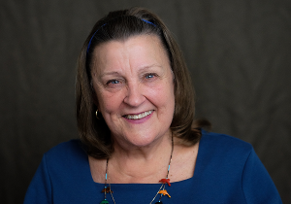
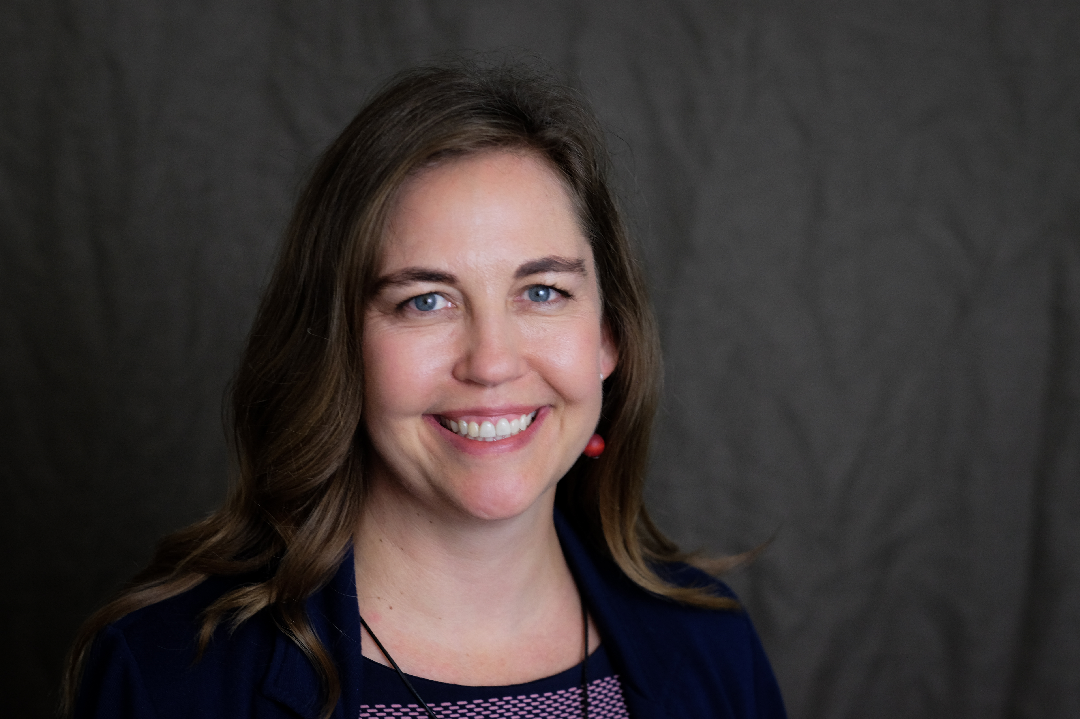
About Us
Joy Zabala
jzabala@cast.org​
@joyzabala
CAST’s Mission is to Transform Education Design and Practice Until Learning Has No Limits. CAST created Universal Design for Learning (UDL), research-based set of principles to guide the design of learning environments that are accessible and effective for all.
Janet Peters​
jpeters@cast.org​
@JanetLPeters​

Slide 4
"Crisis forces commonality of purpose on one another."
-Michelle Dean

Slide 5
Goal
The goal of this session is to
Offer a systems approach for thinking and operating during the crisis
Focus on technology-supported distance learning as a major component of a system of supports
Highlight four areas that support the systems thinking
Gather areas of interest or concern for participants

Slide 6
POLL 1
Please share your focus area

Slide 7
POLL 2
Where are you joining us from?

Slide 8
Introduction to CITES

Slide 9
Center on Inclusive Technology and Education Systems
The overarching goal of CITES is to increase the effective use of Assistive Technology (AT) and Educational Technology (EdTech) by students with disabilities and their families by building the capacity of school districts to implement comprehensive and sustainable systems for the effective use of AT and EdTech.

Slide 10
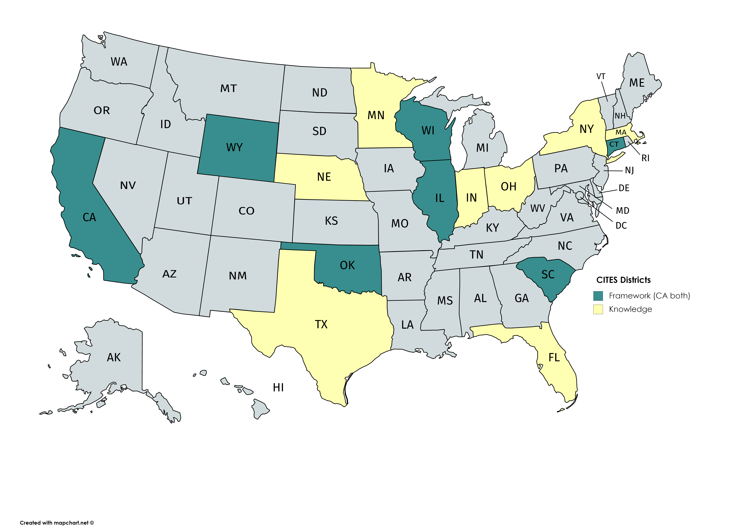
Working With Districts Nationwide
Lessons learned from Knowledge Development Districts
Targeted technical assistance to Framework Development Districts
Universal technical assistance to all districts, especially as we weather this time of crisis

Slide 11
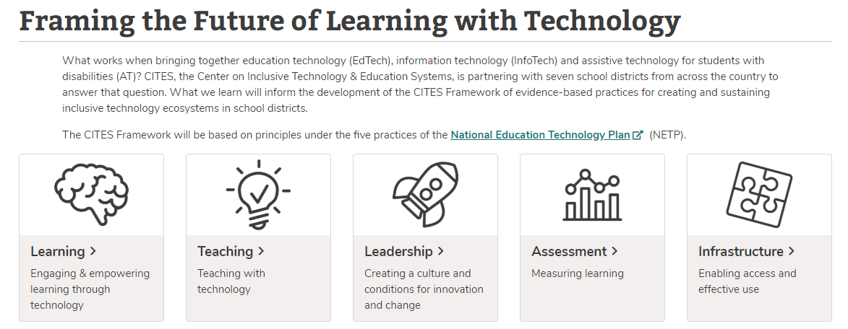
CITES Framework and the National Education Technology Plan (NETP)
CITES is using the NETP as a foundation for our Framework

Slide 12
The Time Is Now!
If technology systems work together, it increases the chances for students to be successful learners in this new distance education environment.

Slide 13
4 Cs to Focus On

Slide 14
4 Cs
Technology
Coordination
Collaboration
Communication
Continuity
Continuity
Communication

Slide 15
4 Cs -The Who, The What and the How
The WHO is consistent across all four Cs
Educational administrators, general education teachers, special education teachers, parents and guardians, and students
Leaders in InfoTech, EdTech, and Assistive Technology

Slide 16
Continuity: Getting Started
WHAT? Moving from F2F to Online teaching and learning
HOW?
When possible, continue with what was working and familiar in the classroom setting
Minimize the introduction of new digital materials and technologies
Take it slow. Build on success.
Past
Now
Future

Slide 17
Communication
WHAT? Building a communication system that can be used to build trust, maintain connections, and support work
HOW?
Determine what communication tools and strategies will be used under what conditions
Be clear on who to contact, under what circumstances by what means;
Set schedules that are mutually agreed upon
Notes:
OpenClipart-Vectors on Pixabay

Slide 18
Coordination
WHAT? Coordinate services so that all students and families have what they need to participate and achieve while learning at a distance
HOW?
Determine what tech and strategies are being used and how to build upon them as needed
Provide initial and ongoing support
Develop strategies for students who do not have or cannot benefit from online work
Notes:
Image by skeeze on Pixabay

Slide 19
Collaboration
WHAT? InfoTech, EdTech and AT leaders work together to ensure technology systems are understood and can be used by all.
HOW?
Provide initial and ongoing support to increase the ability of school personnel, students and families to use the technologies
Focus on accessibility options built into general technology systems and software
Strive for interoperability of AT with general education technologies
Notes:
Image by skeeze on Pixabay

Slide 20
Continuity: In the Future
WHAT? Consider lessons learned and review data to determine what worked, which tools and strategies will be kept and which will be discontinued
HOW?
Determine what effectiveness "looks like"
Keep data on which tools and strategies "worked" during the crisis
Analyze data to inform decisions
Notes:
Image from https://commons.wikimedia.org/wiki/File:Straight_Line_Steady_2.svg

Slide 21
Special Considerations for Students with IEPs

Slide 22
Q & A on Providing Services
If an LEA continues to provide educational opportunities to the general student population during a school closure, the school must ensure that students with disabilities also have equal access to the same opportunities, including the provision of a Free and Appropriate Public Education (FAPE).
- US Department of Education

Slide 23
CAST Response to Request for Waivers
NO ADDITIONAL waivers are necessary under either the IDEA or Section 504 of the Rehab Act
Consortium for Citizens with Disabilities Letter
Council for Exceptional Children Response CARES Act
Learning Disabilities Association of America

Slide 24
Everyone Has a Role To Play
Administrators
Special Education Teachers
General Education Teachers
Education Technology Staff
Families
Notes:
Image by Pixabay
Source: SETDA eLearning Resource

Slide 25
Tips for Communicating with Families
The most important point in these first few days or weeks is to emphasis relationships, establish a presence and not sending out volumes of content.
Communicate clearly with parents the eLearning platform, apps, or software the district will be using
Provide parents with an opportunity to ask plain language questions about whether a technology will work for their child, especially if that child uses assistive technology.

Slide 26
Challenges and Opportunities
AT Use
Technology Access
Parent Technology Ability
Language Barriers
Financial and Other Stressors at home
Family Connection with Teachers
AT and EdTech Systems Synchronized
In Flexible Learning Some Students May Shine

Slide 27
Time for Q&A

Slide 28
"Start where you are. Use what you have. Do what you can."
-Arthur Ashe

Slide 29
RESOURCES
AEM COVID-19 Resources
AT Act Projects by State
ATIA COVID Resources
CAST COVID Response
Center for Parent Information & Resources
SETDA Coalition of eLearning Accessibility

Slide 30
Thank you! Keep in touch!
Website: cites.cast.org
Email: cites@cast.org
Phone: 781-245-2212
200 Harvard Mill Square, Suite 210 Wakefield, MA 01880
EVALUATION LINK: https://www.surveymonkey.com/r/ZMMG2JN
Notes:
EVALUATION LINK: https://www.surveymonkey.com/r/ZMMG2JN

